Slide 1
How to Complete LMS Training
A visual guide

Slide 2
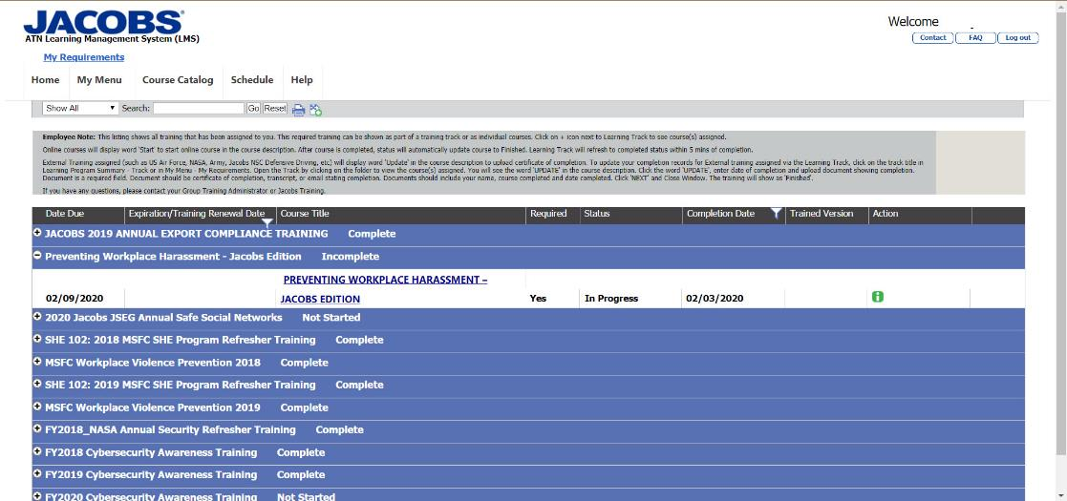
Step 1 – Click on the link to the course

Slide 3
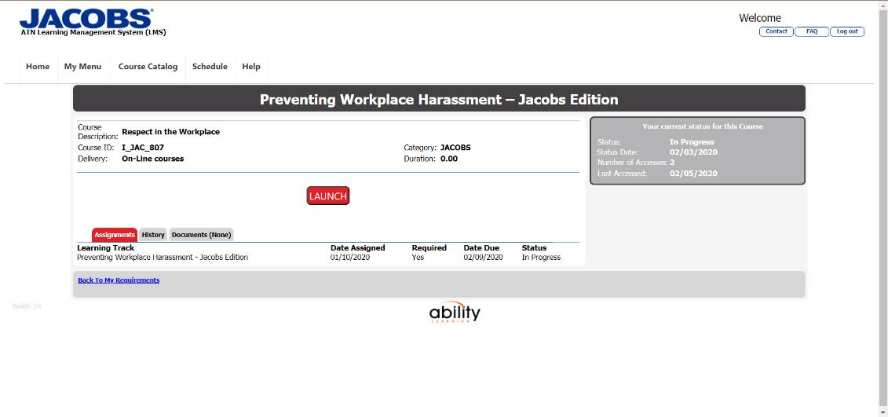
Step 2 – Launch the course

Slide 4
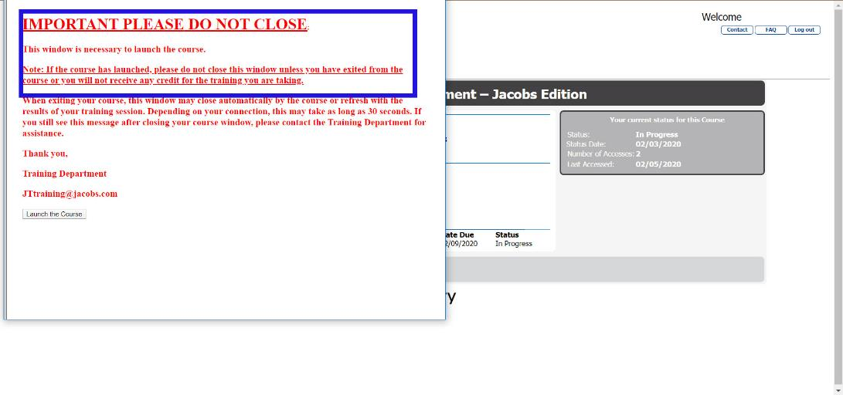
Step 3 – Click Launch in Pop Up Window

Slide 5
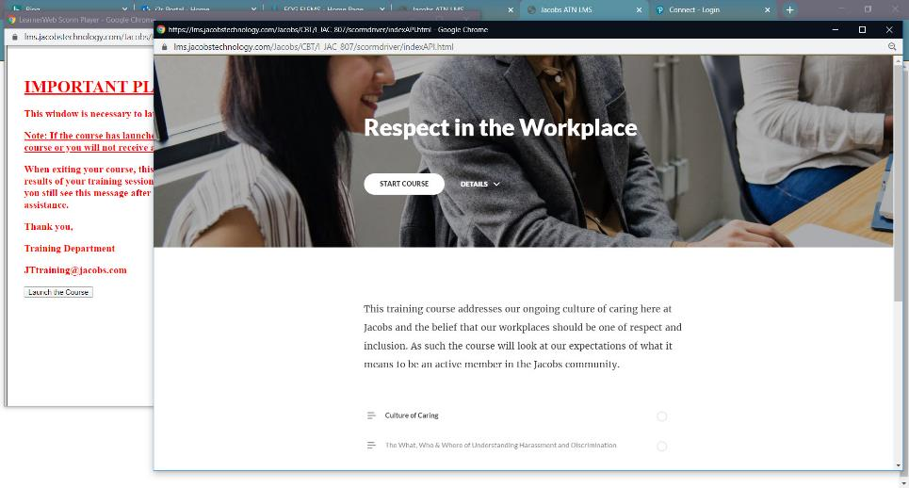
Step 4 – Launch and Take the Training – Leave all windows open in background

Slide 6
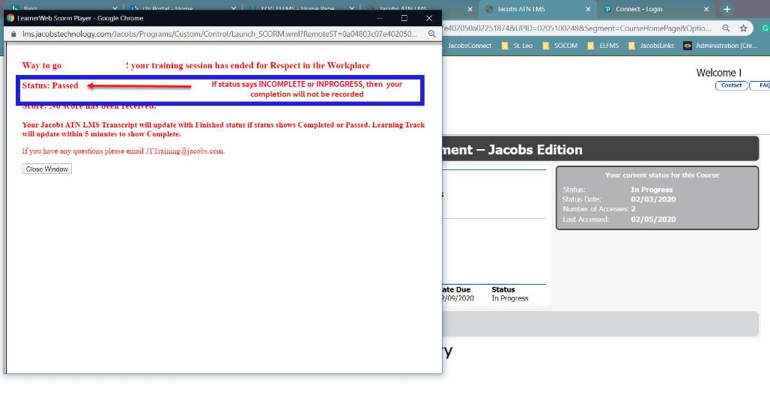
After Completion the Pop Up Screen will Show Completion Status

