Slide 1
ServiceNow (SNOW)
Jacobs Global People Services (GPS)

Slide 2
Accessing ServiceNow
What is ServiceNow
What is found on the home page
Examples on how to use SNOW

Slide 3
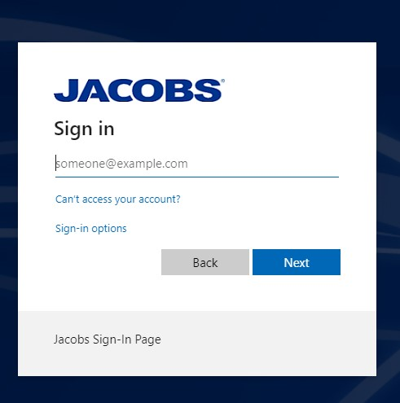
Accessing ServiceNow: Jacobshr.Service-Now.com
Enter Jacobs email address
Passcode
Enter number from Jacobs Security Token (eToken fob or MobilePass) or
GRIDSURE > leave blank
Password
Enter JAMIS (timesheet) password

Slide 4
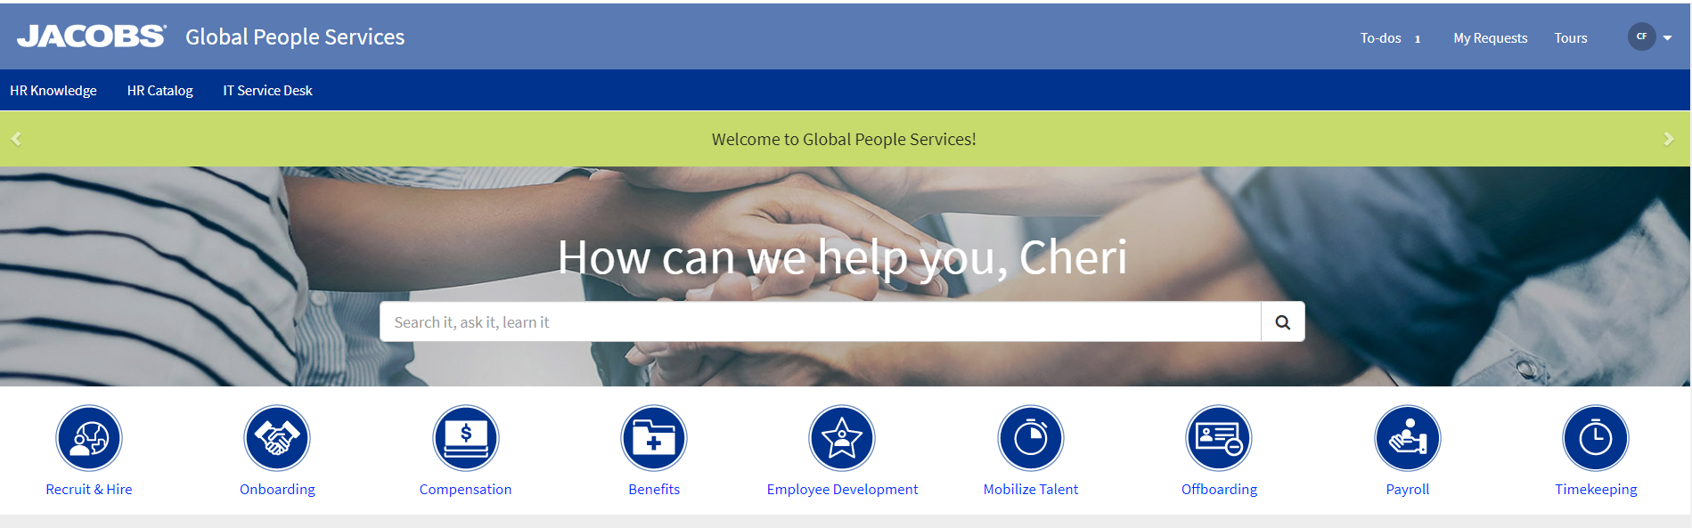
ServiceNow (SNOW)
Self Service platform to search for answers and knowledge on HR topics.
System is also known as Jacobs Global People Services (GPS).

Slide 5

SNOW Home Page
HR Knowledge
Quick link to top searches
HR Catalog
Quick link to submit questions to HR by topic
IT Service Desk
Quick link to I2S IT email address
To-do
Link to actions required by you for tickets that have been submitted
My Requests
Quick link to tickets you have submitted
Tours
Links to record training for ServiceNow
Circle with your initials
Quick link to your profile

Slide 6
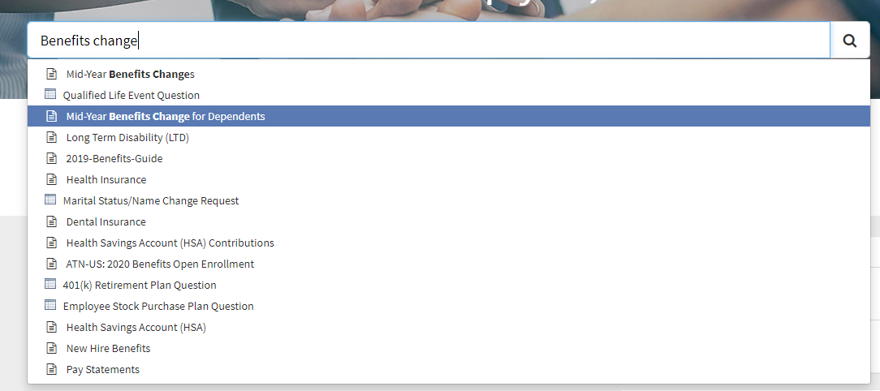
SNOW Search Bar
Type key words to search data base
Similar to a “Google” search

Slide 7
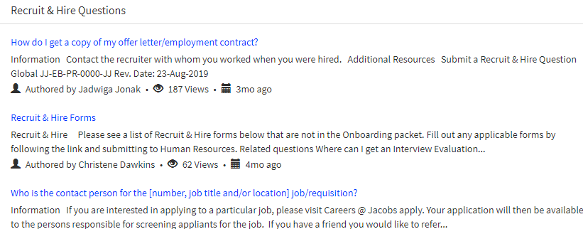
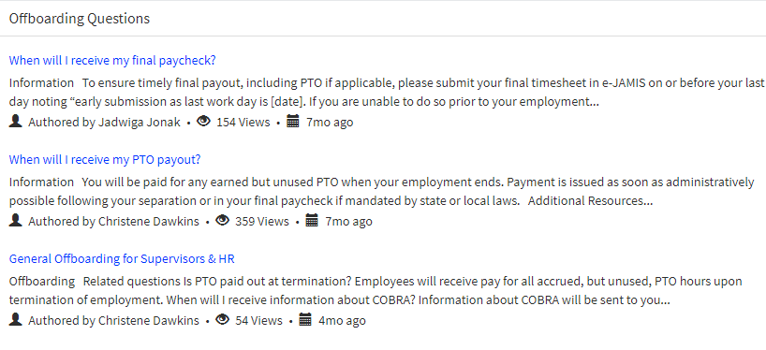
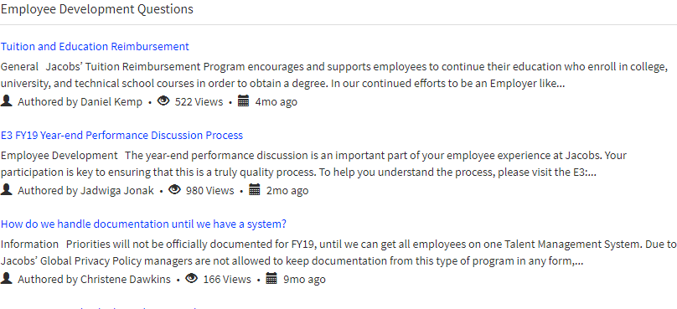
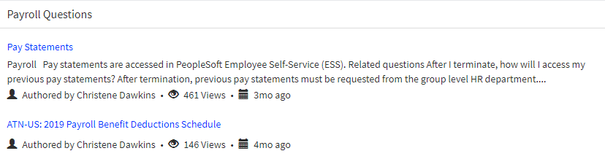
Quick link icons
Quick links to common questions/searches
Select icon to view frequently search topics

Slide 8
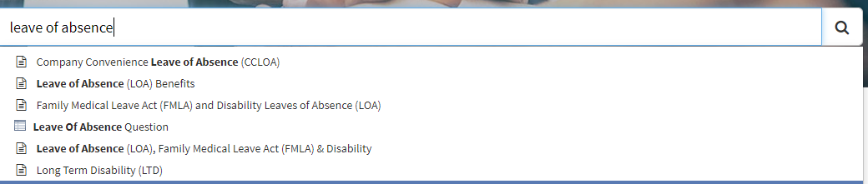
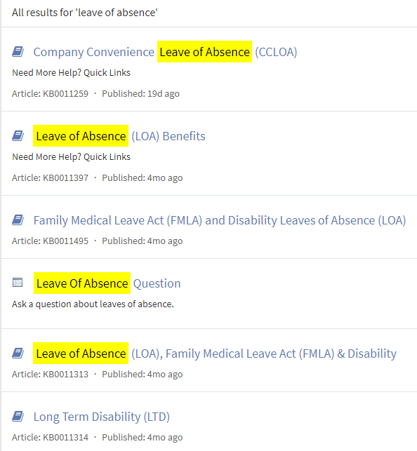
Search Topic: Leave of Absence - example
Leave of Absence
Search results

Slide 9
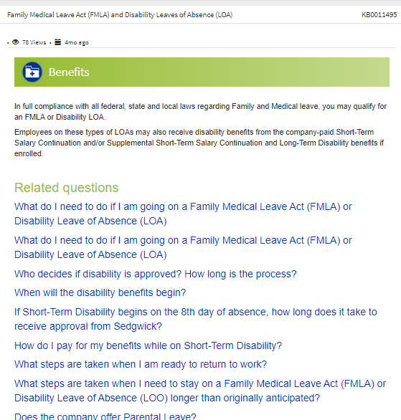
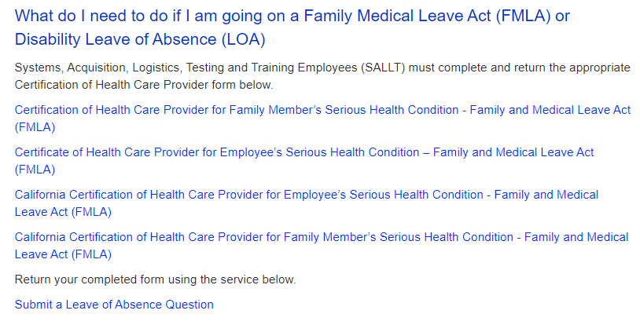
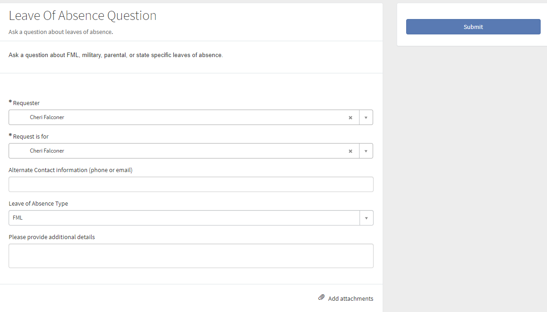
Search Topic: Leave of Absence - example (continued)
Select Article
Review information
If necessary, submit question to HR

Slide 10
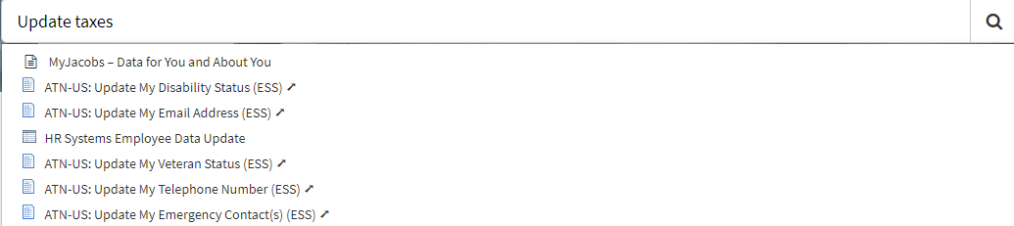
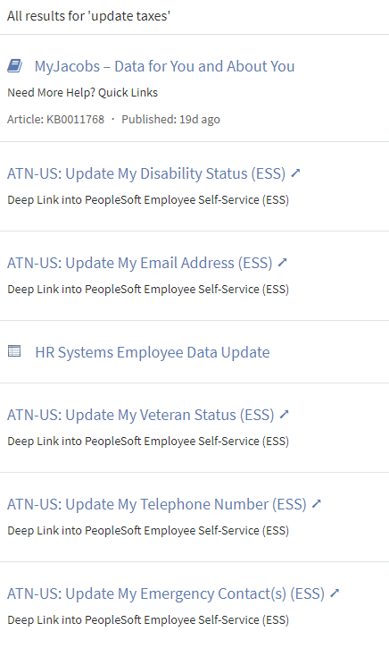
Search Topic: Taxes – example
Update Taxes
Search results

Slide 11
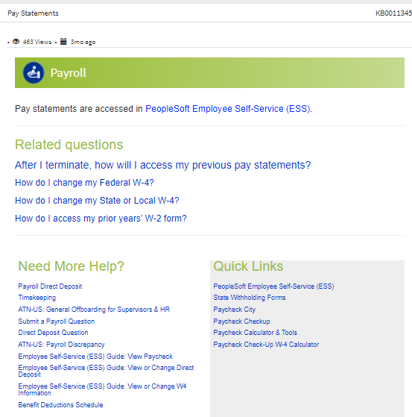
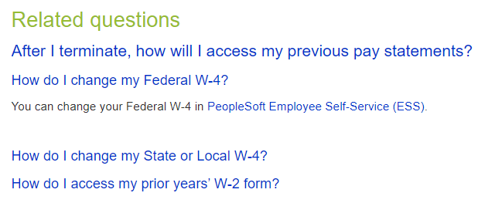
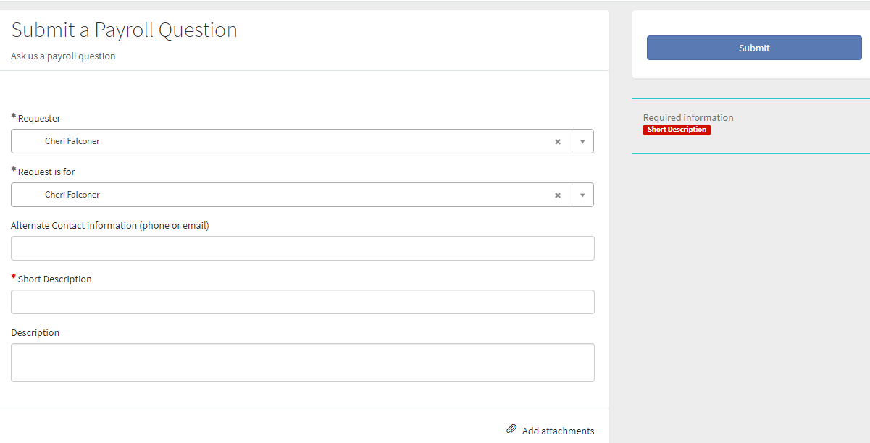
Search Topic: Taxes – example (continued)
Select Article
Review information
If necessary, submit question to HR

Slide 12
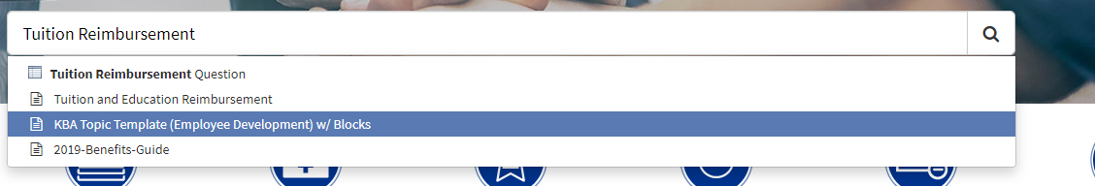
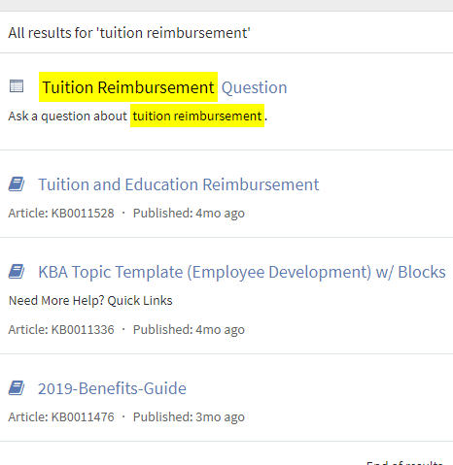
Search Topic: Tuition Reimbursement - example
Tuition Reimbursement
Search results

Slide 13
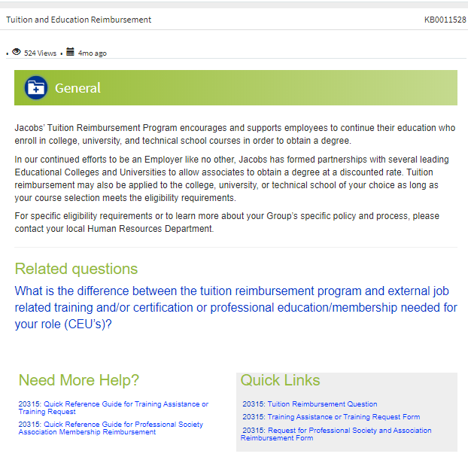
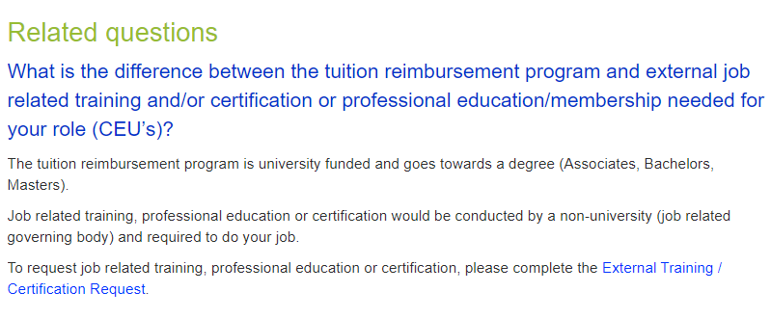
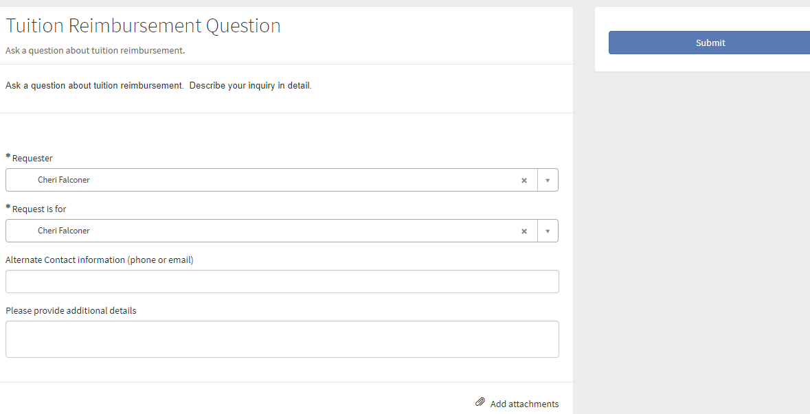
Search Topic: Tuition Reimbursement - example (continued)
Select Article
Review information
If necessary, submit question to HR

Slide 15
ServiceNow (SNOW)
Global People Services (GPS)

